Slide 1
The RUSH76™ Chopart
Lamination Guide

Slide 2
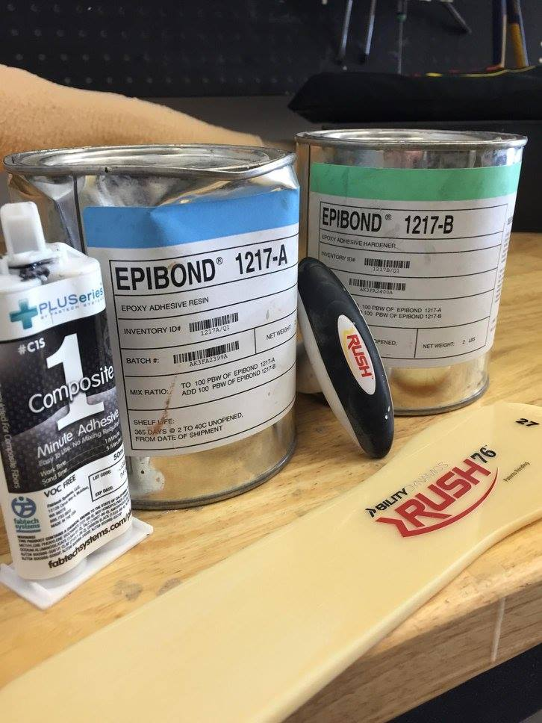
The Ability Dynamics RUSH76™ Chopart Plate is designed for lower limb usage. It is designed/intended for bonding and lamination onto/at the distal end of a prosthetic socket. The RUSH76™ is designed to be a dynamic foot plate for activity levels of K3 and K4. It is also suitable and comfortable for K2 usage. Build height is 17mm (based on 27cm). This presentation is intended to provide general guidance when integrating the RUSH76™ Chopart into a socket.
rushfoot.com

Slide 3
1. Apply cast sealer to positive cast.
rushfoot.com

Slide 4
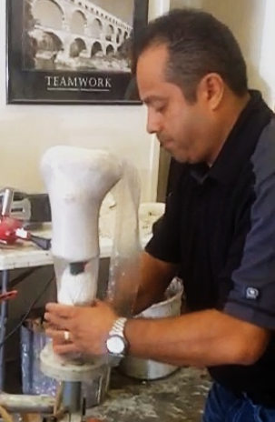
2. Apply appropriate PVA bag to positive mold.
rushfoot.com

Slide 5
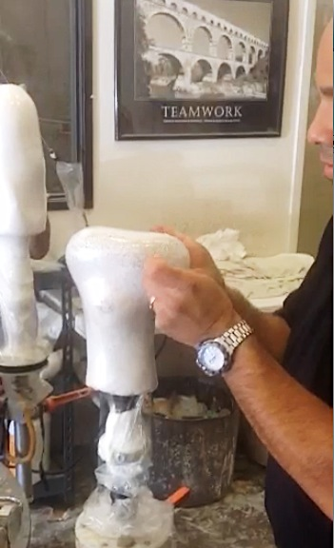
3. Apply distal PVA cap.
rushfoot.com

Slide 6
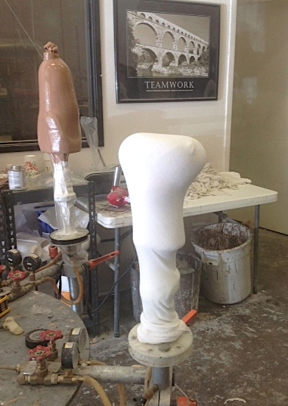
4. Apply appropriate layup materials.
rushfoot.com

Slide 7
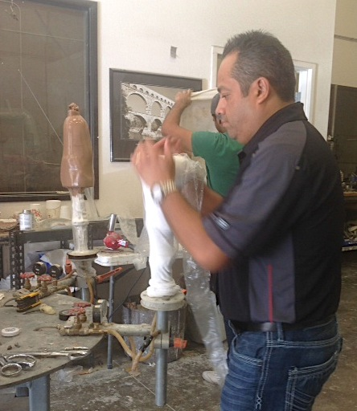
5. Apply second (outer PVA bag).
rushfoot.com

Slide 8
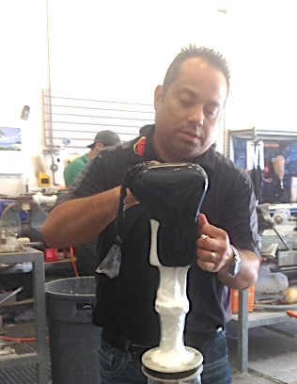
6. Add resin and spread evenly under vacuum. Once cured, remove the PVA bag.
rushfoot.com

Slide 9
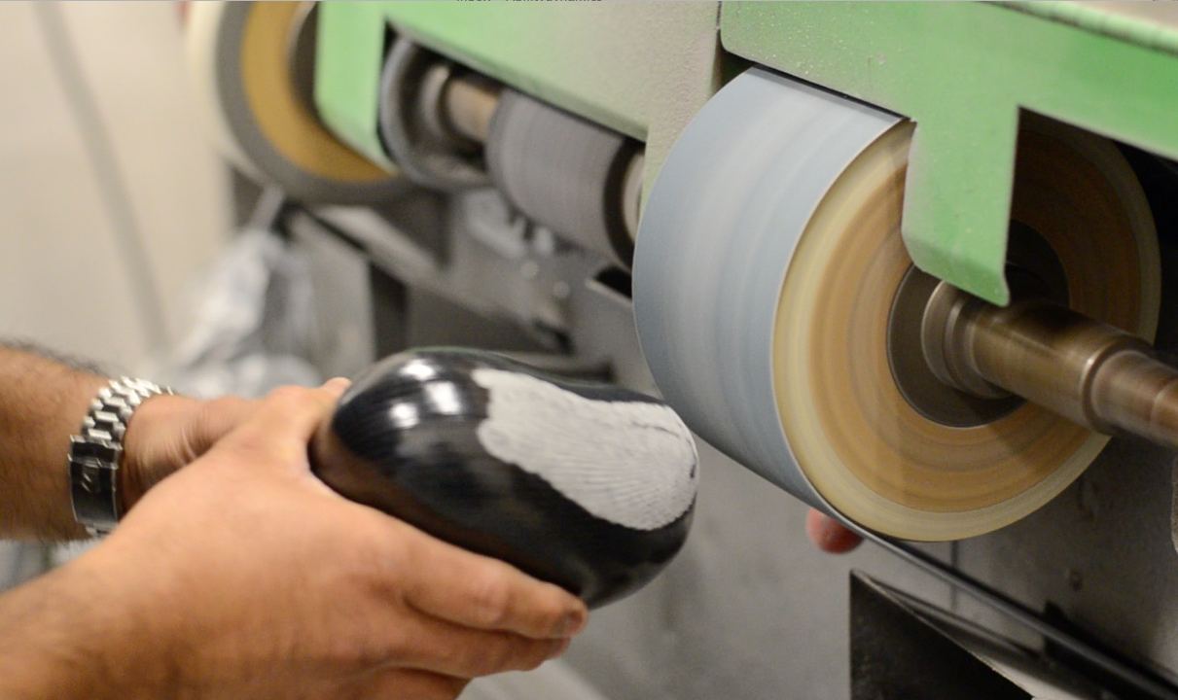
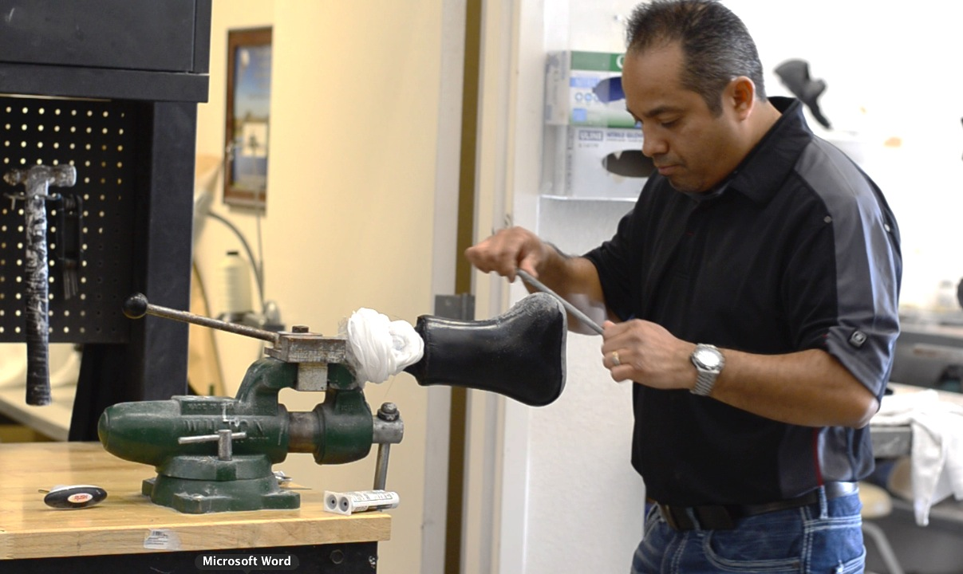
7. Scuff prep the contact surface of the cast.
rushfoot.com

Slide 10
8. Use screen or fine grit sandpaper to scuff Chopart plate on the 1/3 volar portion (as show of the Chopart plate only. Avoid deep sanding to protect the fibers of the laminate.)
1/3
rushfoot.com

Slide 11
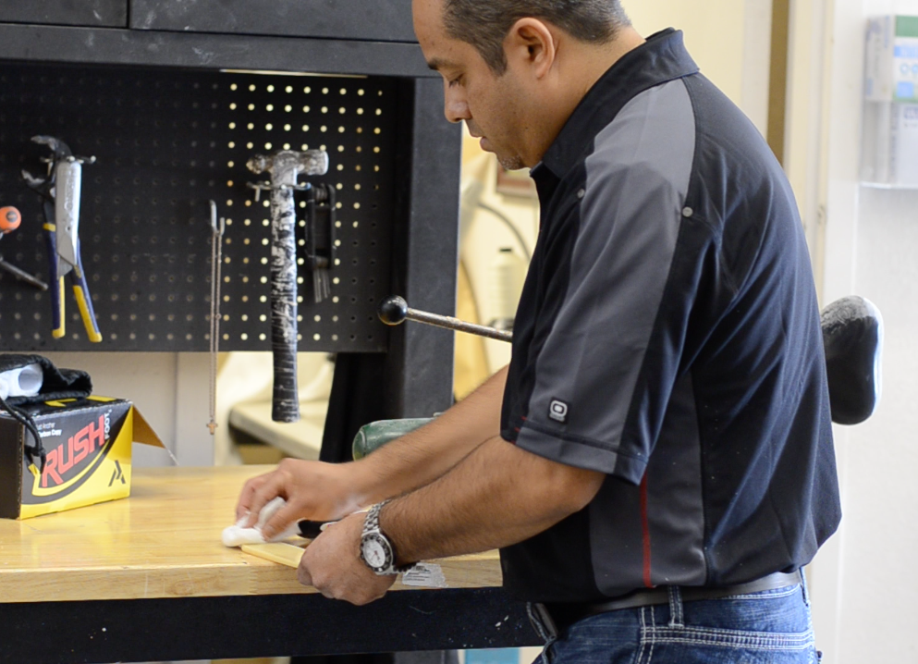
9. Clean upper and lower surfaces of the Chopart plate thoroughly with clean cloth and acetone to remove agents, oils, etc and to ensure best bonding surface.
rushfoot.com

Slide 12
10. Apply generous amount of adhesive to volar surface of RUSH76™ Chopart plate.
11. Apply a 50/50 blend of epoxy adhesive resin and epoxy adhesive hardener.(Other bonding agents include Siegelhartz or FabTech Systems 60 or 90 second two-part adhesive).
rushfoot.com

Slide 13
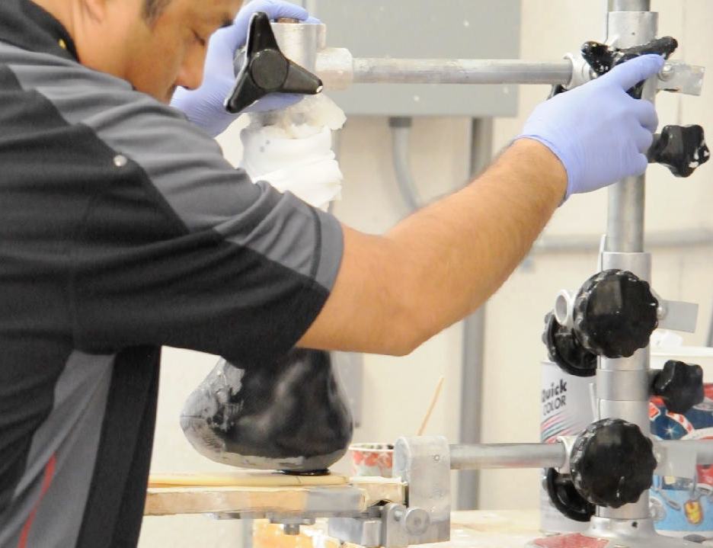
12. Optimize the dynamic performance of the plate by adhering as closely as possible to 1/3 of the Chopart plate. Drop cast down onto Chopart plate and allow to thermoset.
rushfoot.com

Slide 14
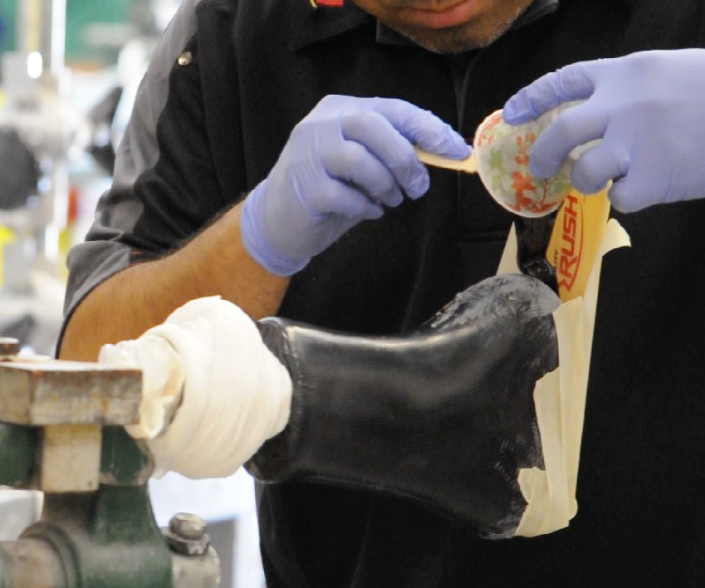
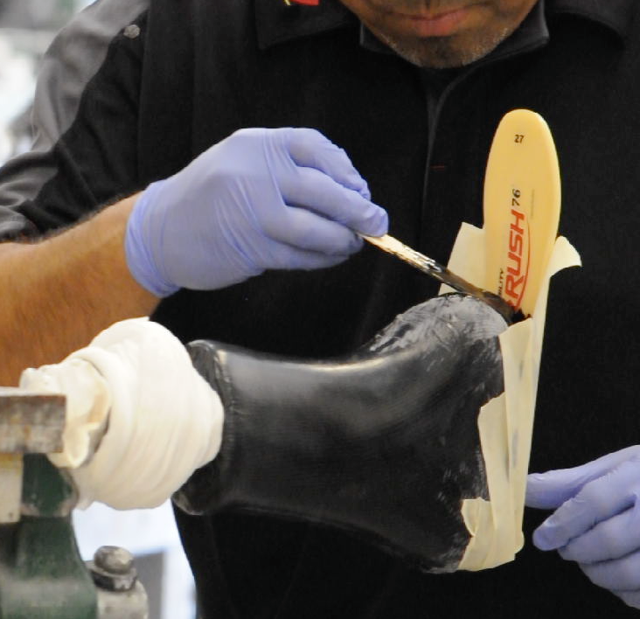
13. Remove from alignment device, secure the Chopart plate with synthetic casting tape or other temporary wrap materials. Fill in voids on the plate to provide support as needed.
rushfoot.com

Slide 15
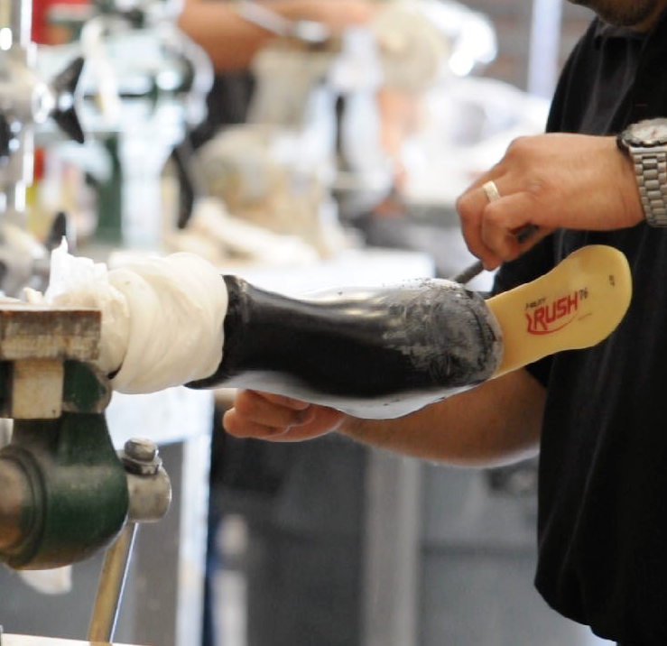
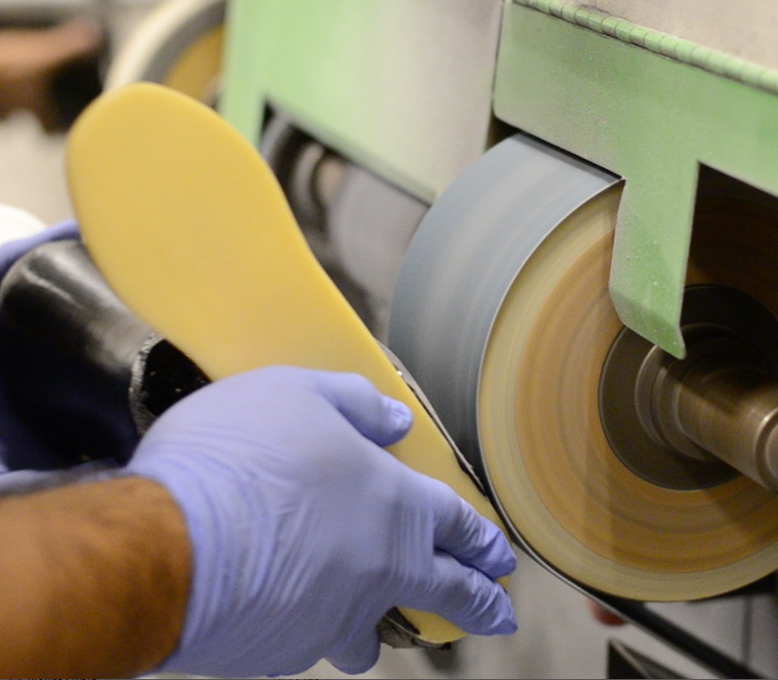
14. Clean off excess bonding agent to ensure smooth edges/transitions prior to second lamination.
rushfoot.com

Slide 16
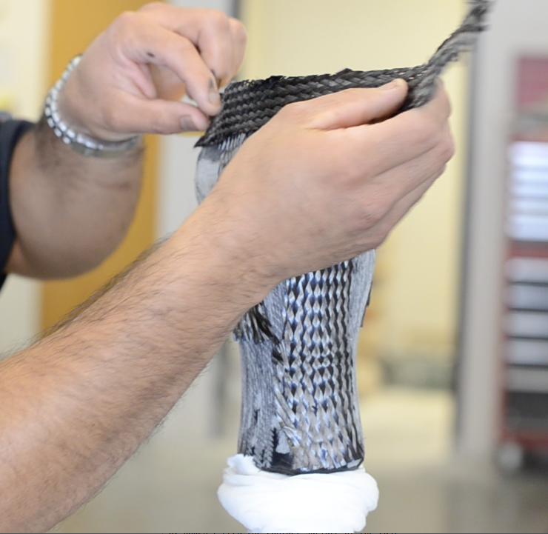
15. Apply carbon tape strips accordingly based on patient weight and impact level. (One strip under posterior 1/3 of plantar surface of the plate.) Increase lamination layers for additional strength.
rushfoot.com

Slide 17
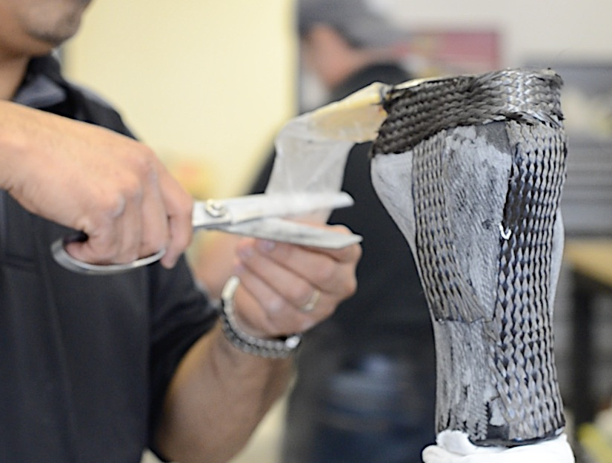
16. Use small PVA bag to cover exposed 2/3 portion of Chopart plate, wrap PVA cover on exposed 2/3 portion of plate with generous amount of PVA tape or electrical tape (This is to create barrier between Chopart composite and second lamination materials.)
rushfoot.com

Slide 18
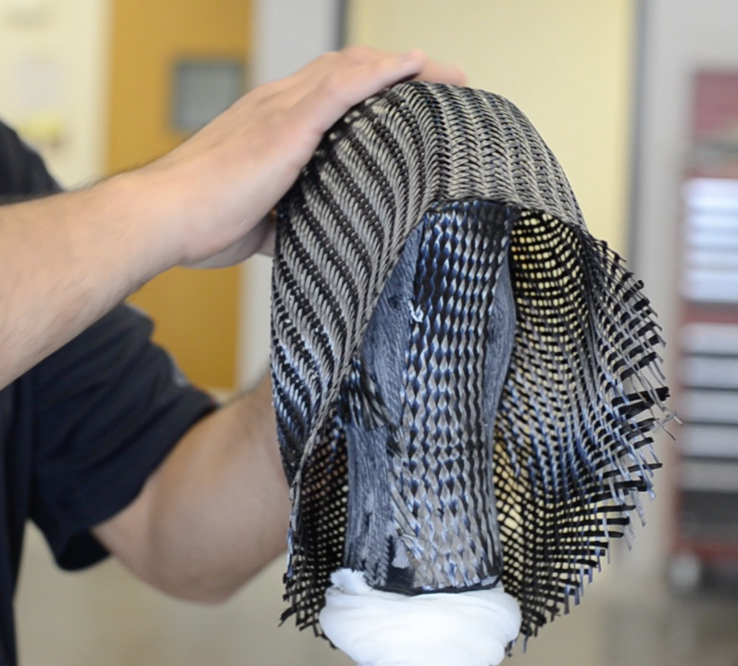
17. Apply the second lamination materials to cast.
rushfoot.com

Slide 19
18. Apply appropriate PVA bag. (A nylon spacer sock is optional, as shown above, to ease the application of the PVA bag. Remove prior to lamination.)
rushfoot.com

Slide 20
19. Pour resin and distribute evenly under vacuum. (The black resin shown above is optional for cosmetic purposes.)
dgfghfgh
rushfoot.com

Slide 21
20. Once cured, remove PVA bag and carefully cut away layup and composite from second lamination from distal 2/3 portion of toe.
21. Add any cut outs or support straps as needed.
22. Apply foot shell, modify if needed.
23. Fit and deliver successfully to patient.
rushfoot.com

Slide 22
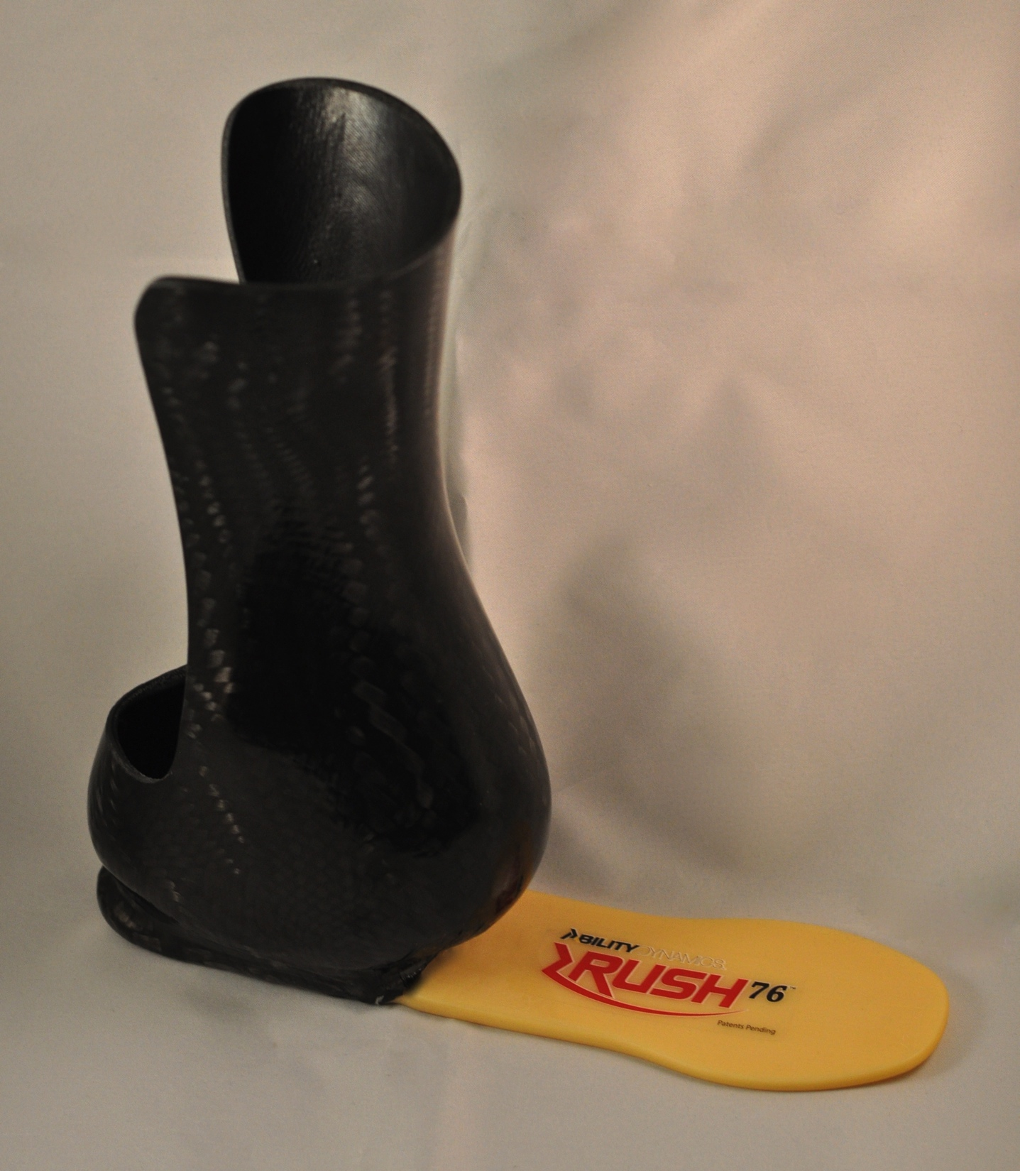
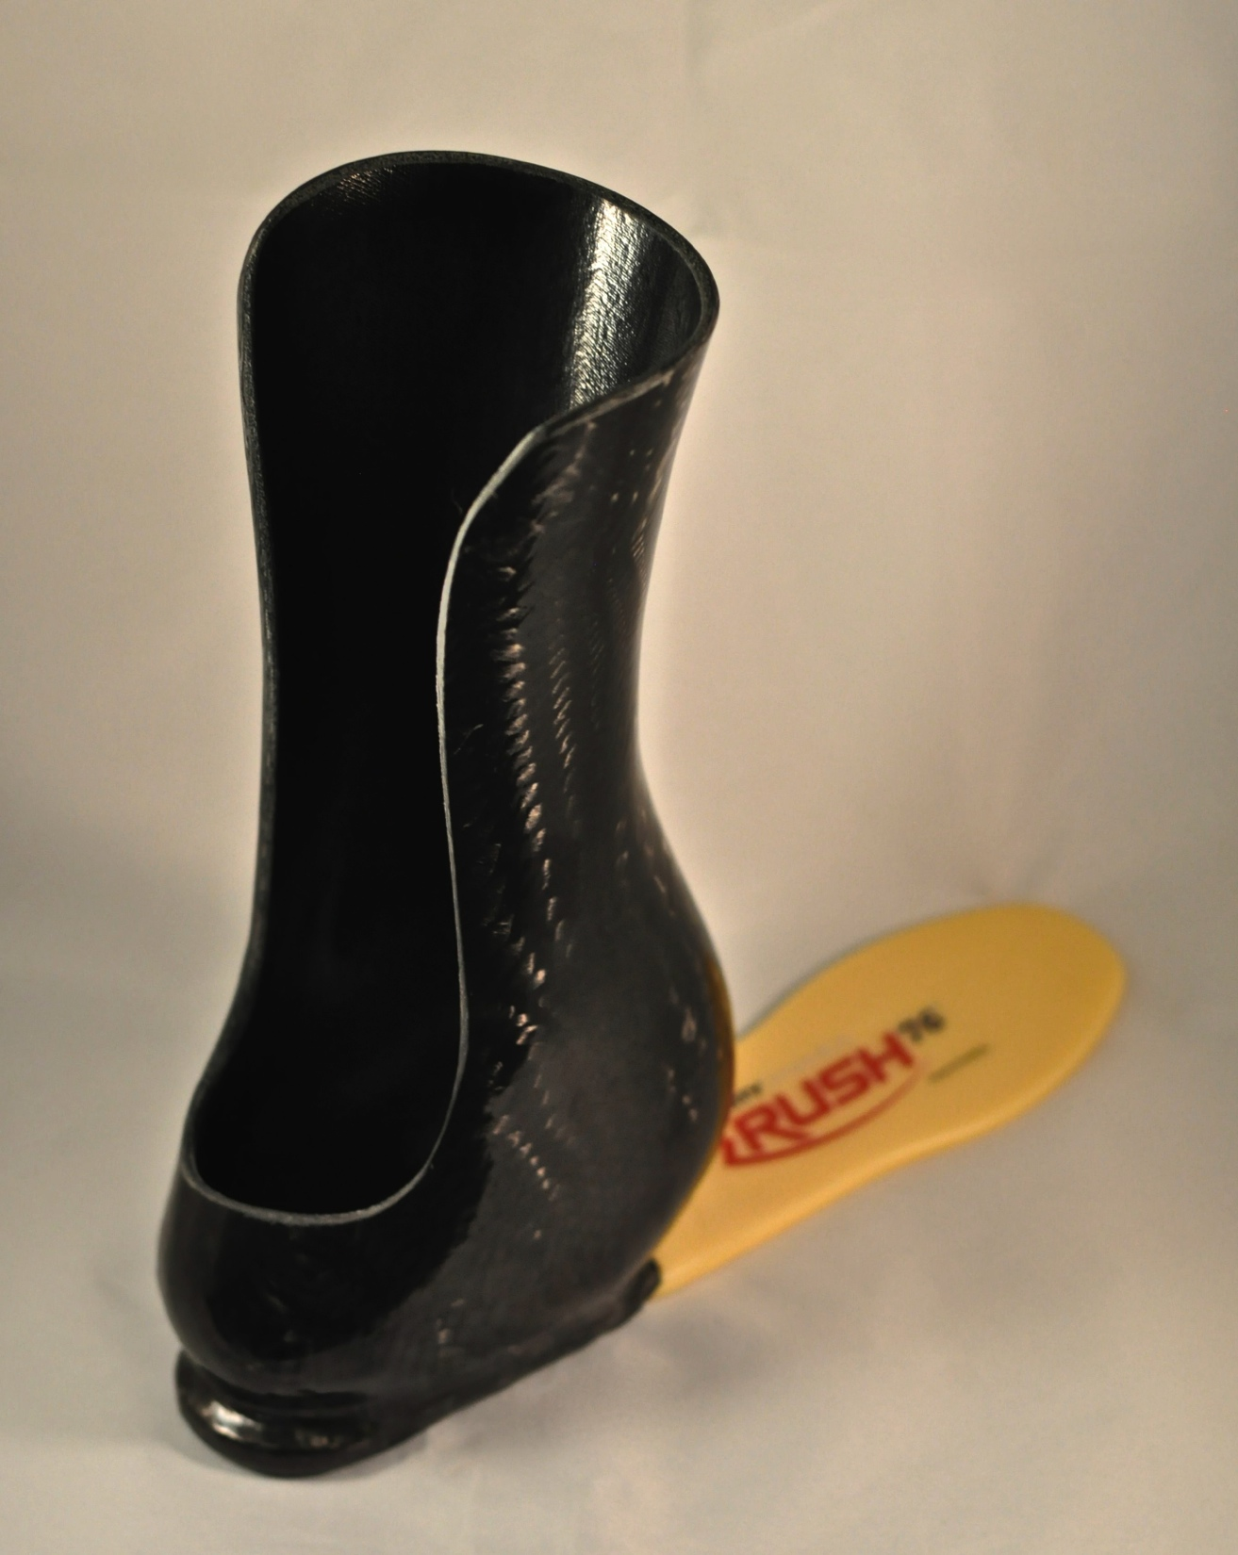
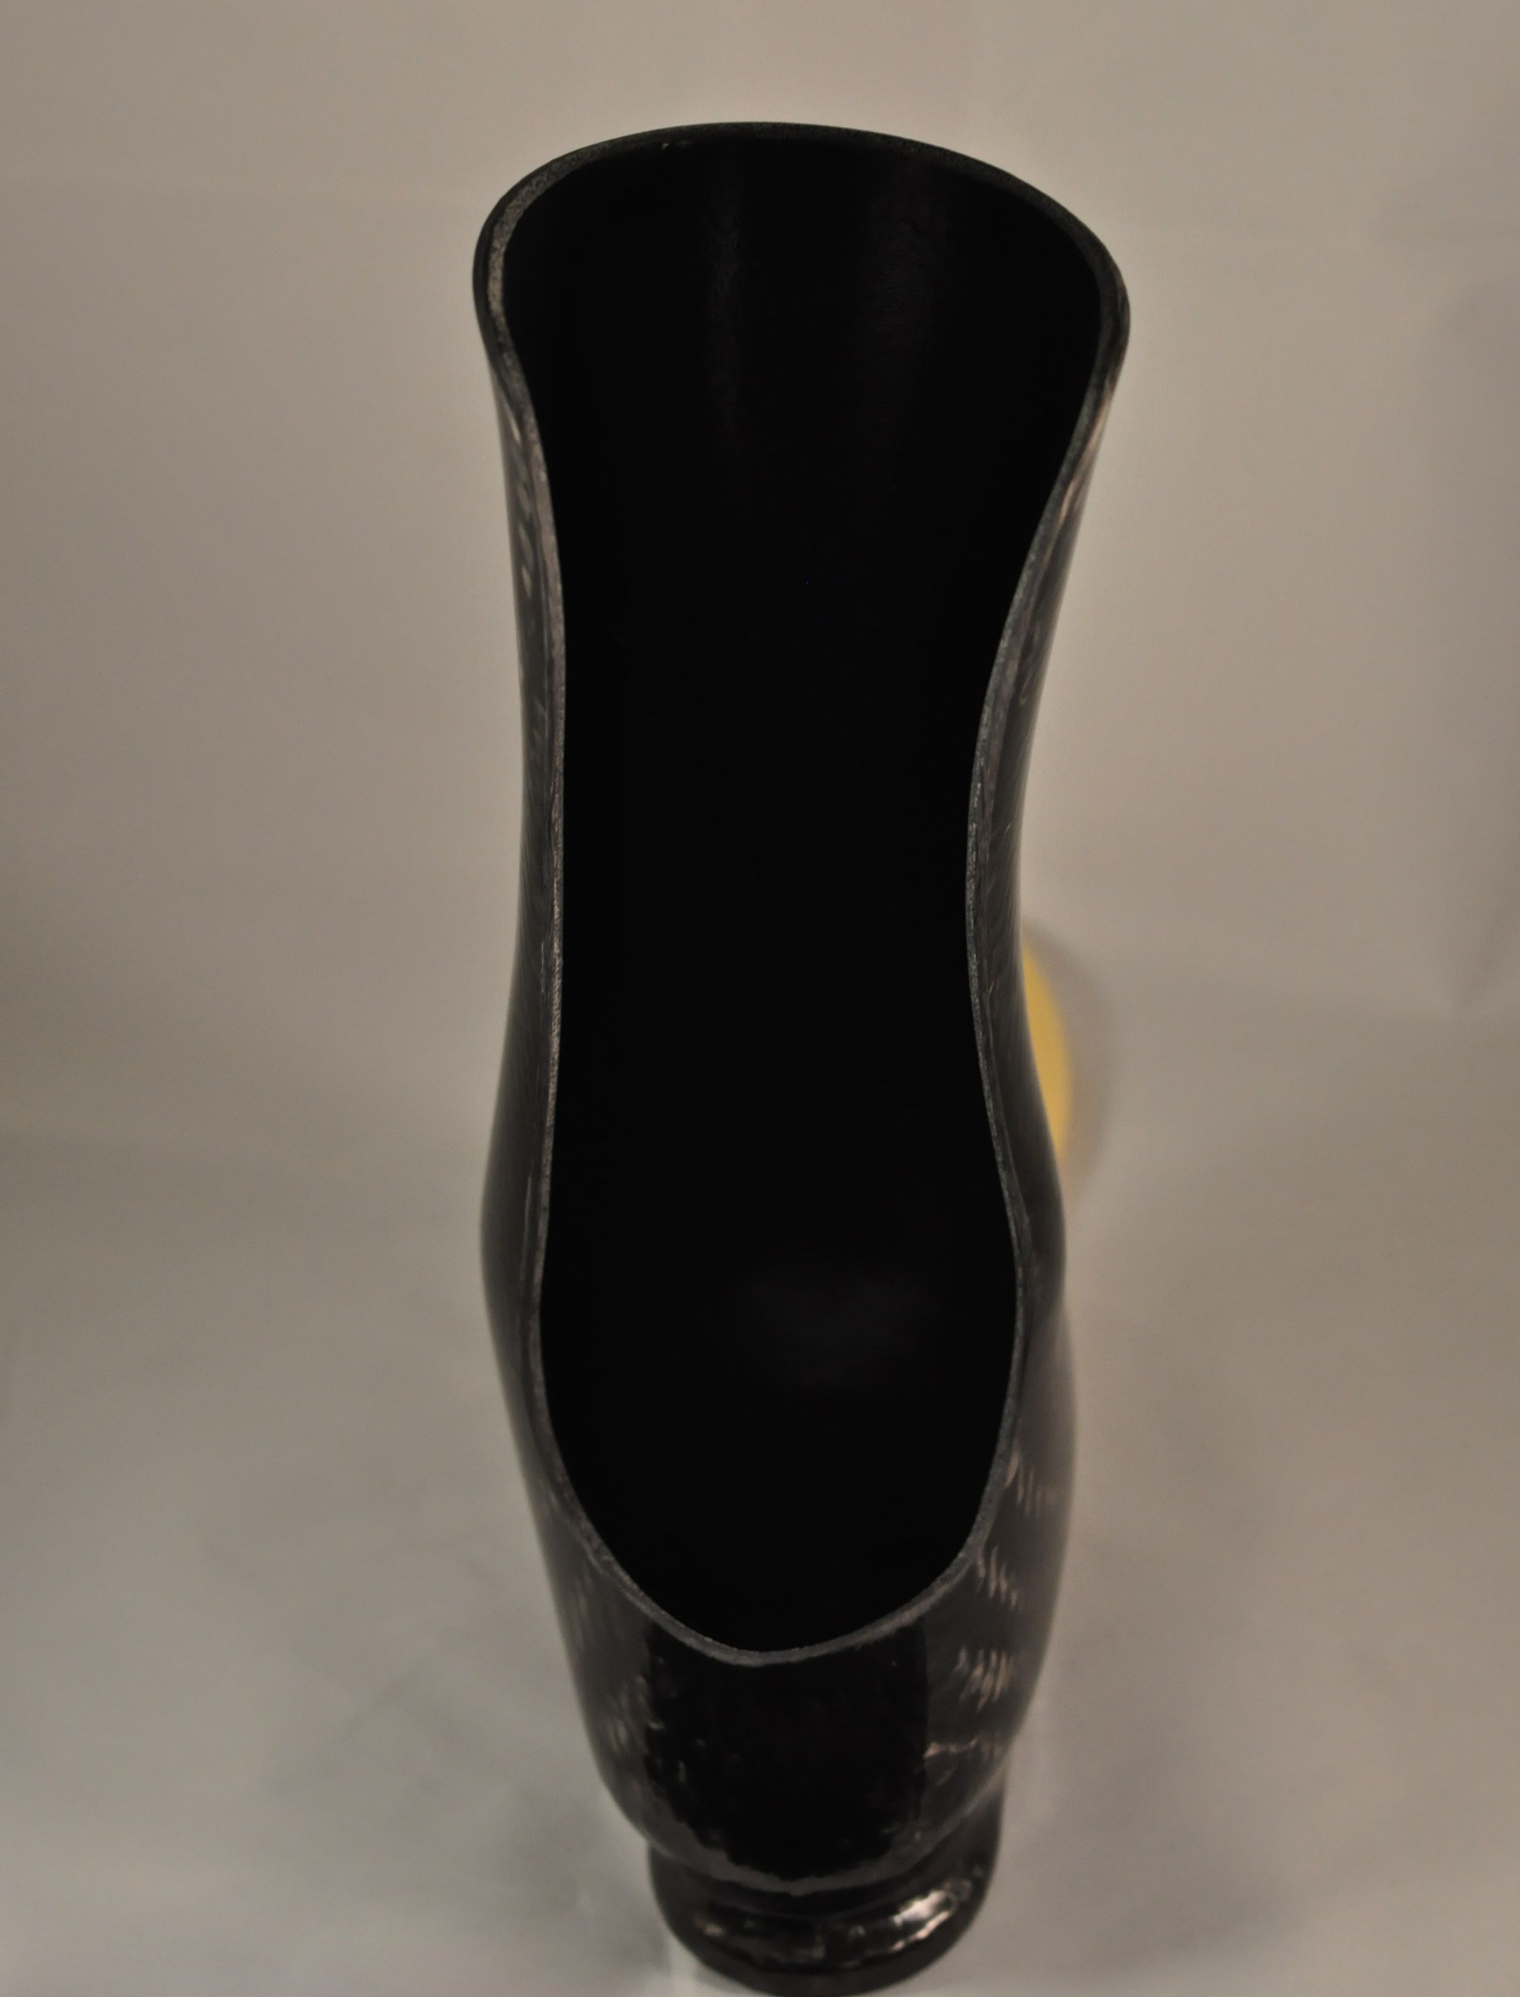
Please feel free to call 855-450-7300 for more information.
rushfoot.com

